Slide 1
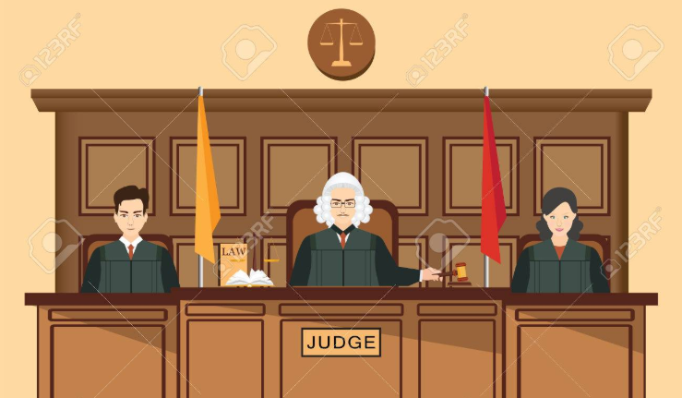
Intelligent Judicial System
Presented By:
Anurag Gate
Bhakti Mehta
Yugal Karamchandani

Slide 2
Agenda
Introduction
Problem Statement
About the Dataset
Data Cleansing
Data Exploration and Feature Engineering
Machine Learning Models
Comparison and Recommendation of Models
Data Analysis and Insights

Slide 3
Introduction
The judicial system is one of the most important pillars of any society, at times this system fails to uphold the very law which it is meant to protect.
Challenges and Problems faced by the judiciary system:
Corruption is one of the issues that plague the court system.
Human state of mind or other human issues like personal conﬂict, prejudice, and moods can lead to biased and unfair trials.

Slide 4

Problem Statement
Prejudice and bias can be an important factor when serving justice. Thus our objective is to create a machine learning algorithm, trained upon years of human experience, which can go a long way in creating an unbiased judiciary system that can help in various matters of law.

Slide 5


About the Dataset
The Supreme Court database is the definitive source for researchers, students, journalists, and citizens interested in analysis of the United States Supreme Court.
The database contains more than two hundred variables regarding each case decided by the Court between the 1946 and 2017 terms.
Variables like the identity of the court whose decision the Supreme Court reviewed, the parties to the suit, the legal provisions considered in the case, and the votes of the Justices etc are included in the dataset.

Slide 6

Features
The dataset consists of features that can be categorized into three categories:
Background variables : Petitioner, Respondent, Jurisdiction, Lower Court Disagreement , Lower Court Disposition, Court Disposition Direction
Chronological variables : Like in which term the decision was handed
Substantive variables : Like the issue and issue area of the case, chief justice, court’s basis of decision and types to laws considered in the case
Outcome variable: partyWinning i.e. if the Petitioner wins or not.

Slide 7
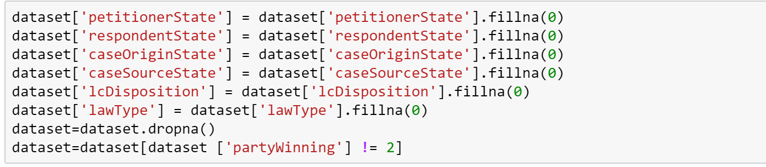
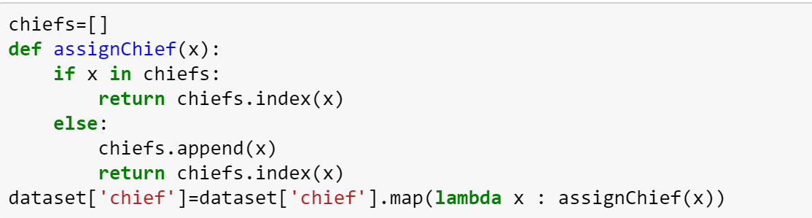
Data Cleansing
1. Filling missing values and removing outliers
2. Enumerating the data

Slide 8
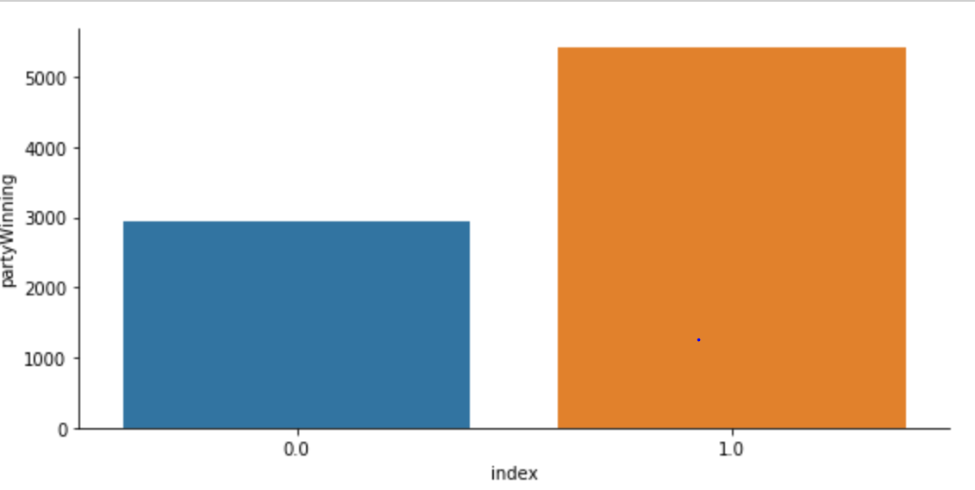
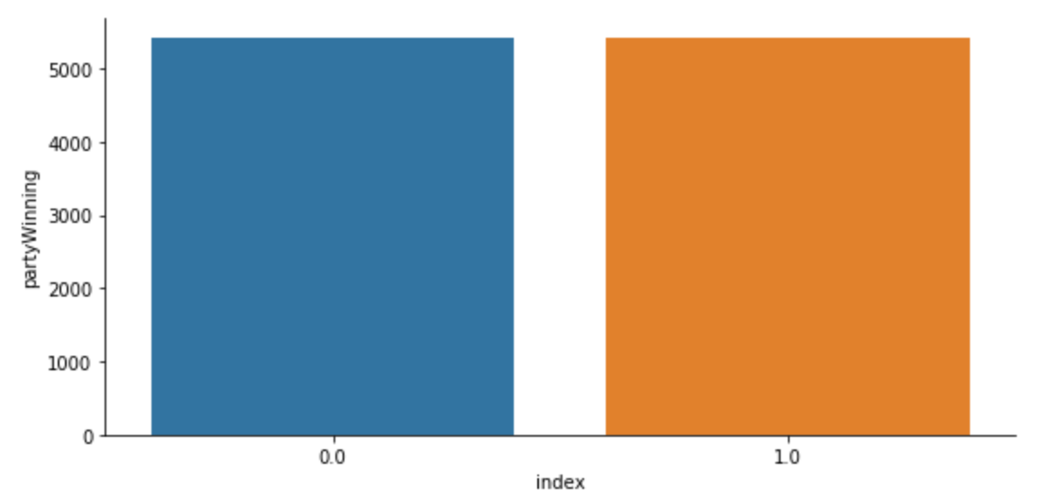
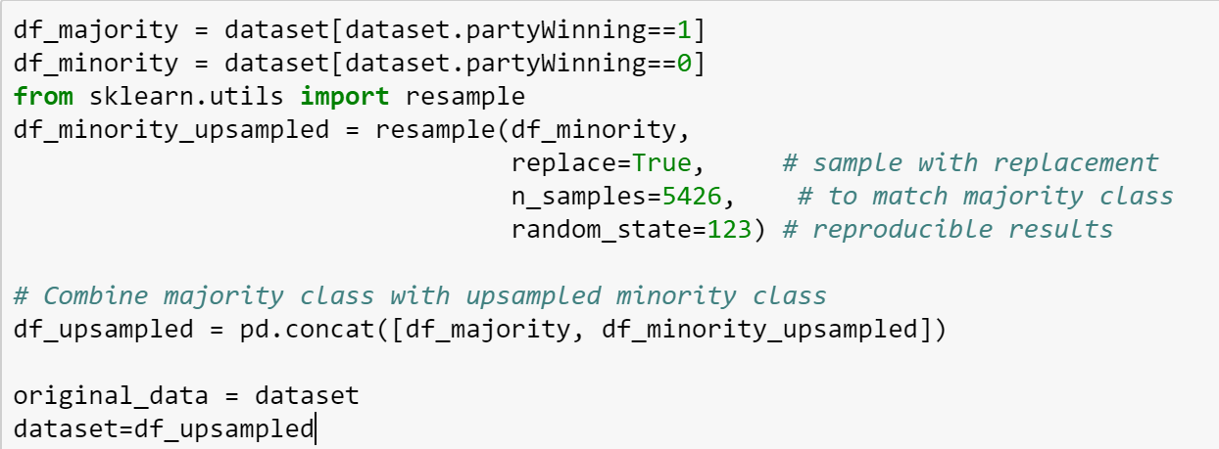
Data Cleansing
C. Balancing the dataset

Slide 9
Data Cleansing
D. Categorizing the data
We have segmented the years into decades.

Slide 10
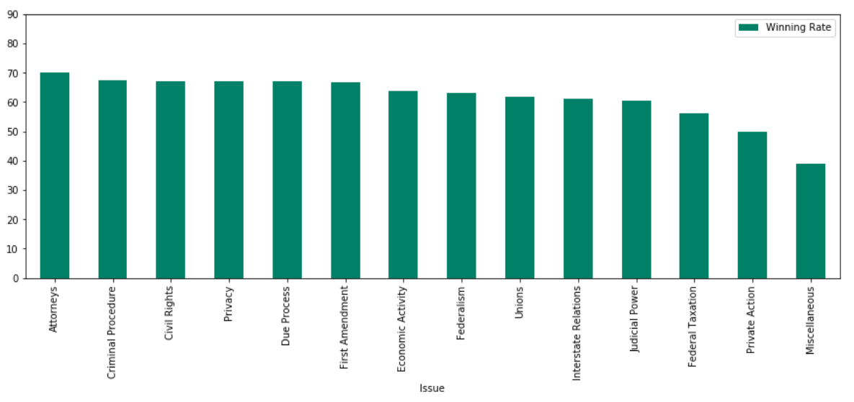
Data Exploration
Finding the Winning Rate of the petitioners across various issues:

Slide 11
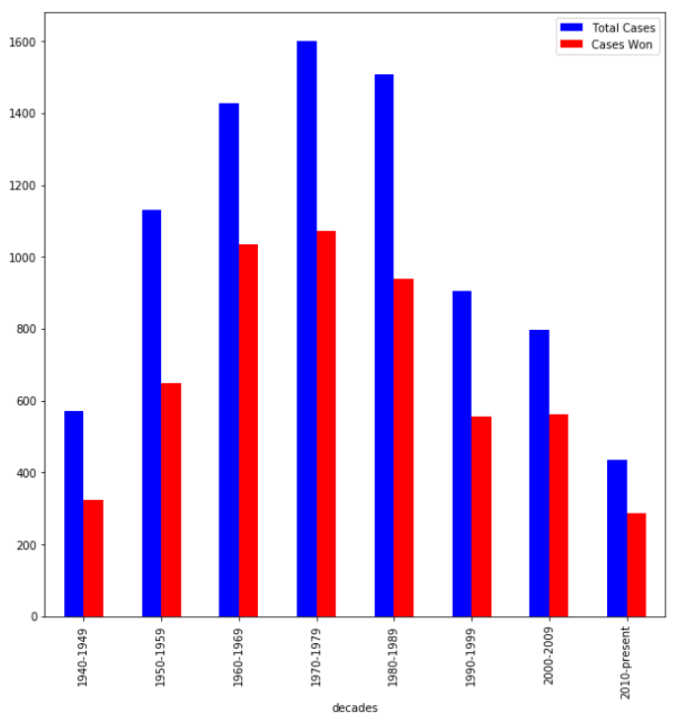
Data Exploration
A look into number of petitions and petitions won over the last few decades:

Slide 12
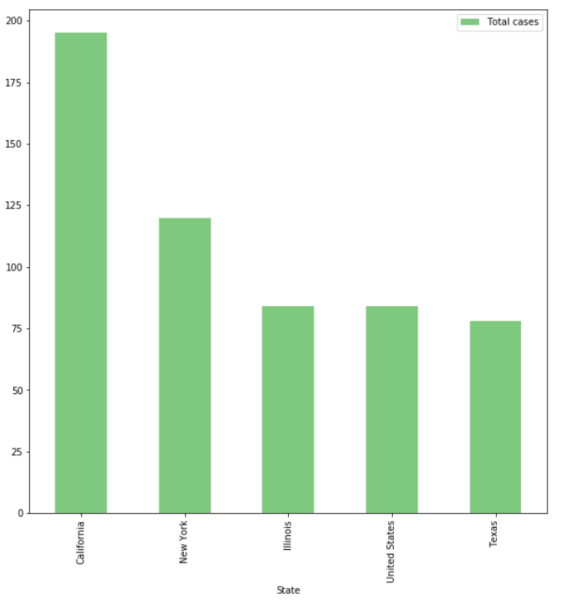
Data Exploration
Top 5 States in the US filing petitions in the United States Supreme Court:

Slide 13
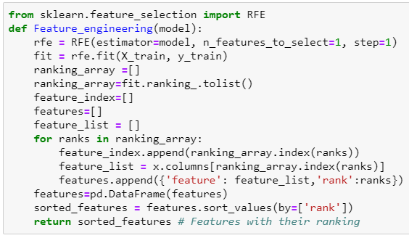
Feature Engineering
We used Recursive Feature Elimination (RFE) as a feature selection method for both the models. It ranks the model’s coef_ or feature_importances_ attributes and helps to eliminate the weak features.

Slide 14
Machine Learning Models
We have used the following models for predicting whether the petitioner will win the case or not
a. Logistic Regression
b. Random Forest
Let’s move to the Jupyter notebook for implementation

Slide 15
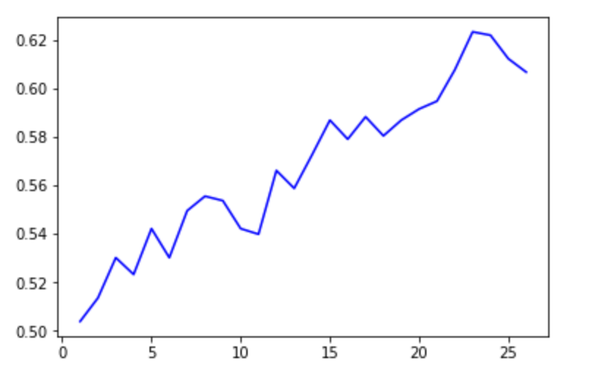
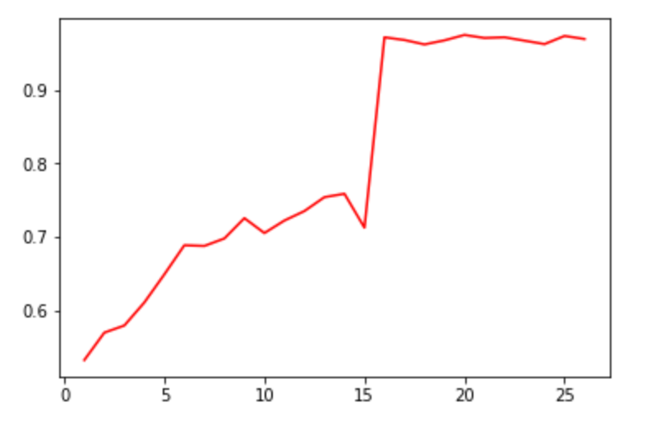
Comparison of Models
Accuracy of Models
 | Logistic Regression | Random Forest
Accuracy
After Parameter Tuning
After Feature Engineering

Slide 16
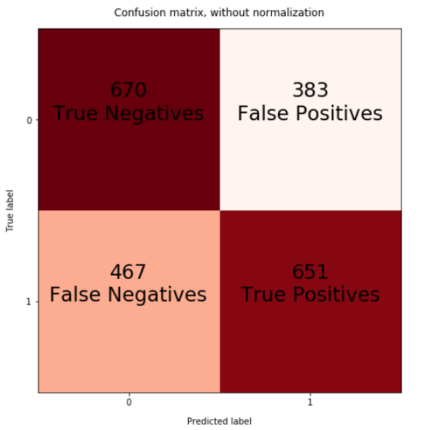
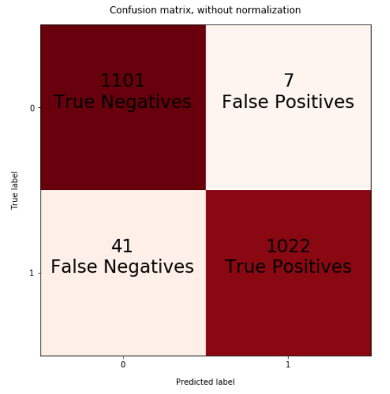


Confusion Matrix
Logistic Regression | Random Forest

Slide 17
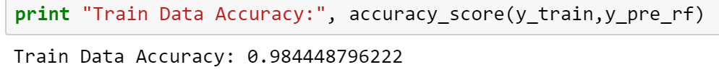
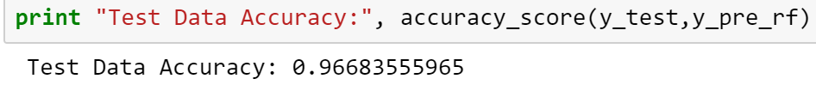
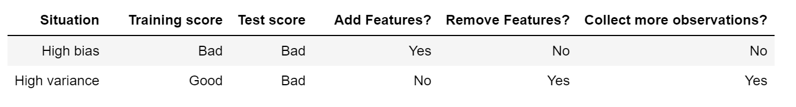
Bias and Variance Trade-off
Logistic Regression | Random Forest
Performance on training data Performance on test data | Performance on training data Performance on test data

Slide 18
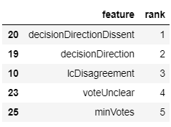
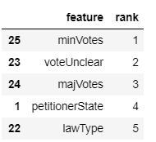
Feature Selection using RFE
Logistic Regression | Random Forest
Top 5 Features | Top 5 Features
Thus, Random Forest performs much better than Logistic Regression for classification of this dataset.

Slide 19
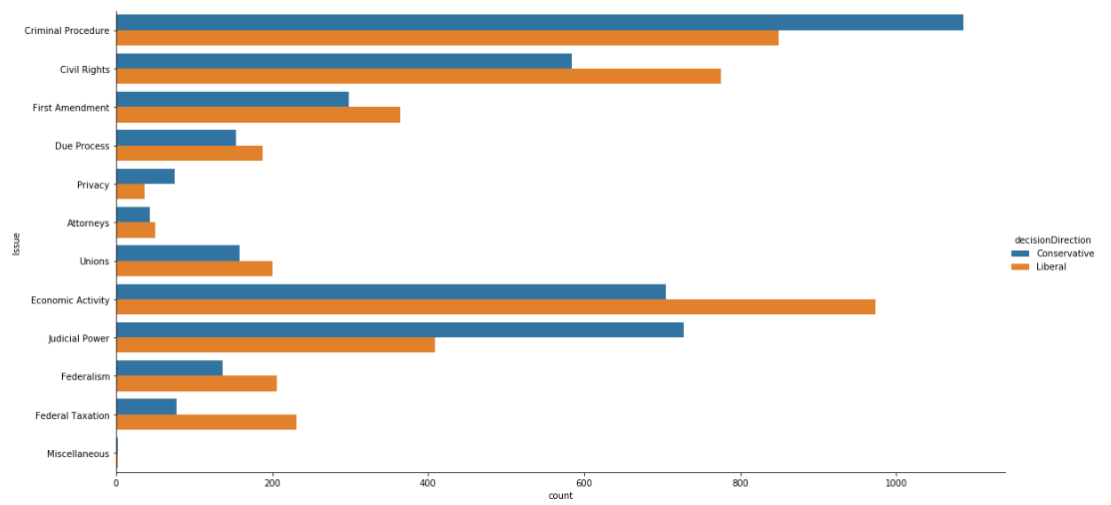
Data Analysis and Insights
Insight 1 : Liberal Vs Conservative Court
In recent years, there has been a high percentage of liberal opinions. But voting liberally on a state law for drawing and quartering jaywalkers is different from voting to free a murderer. Thus as we can see, only in criminal proceedings, Privacy cases and Judicial power cases, the court seems to be mostly conservative

Slide 20
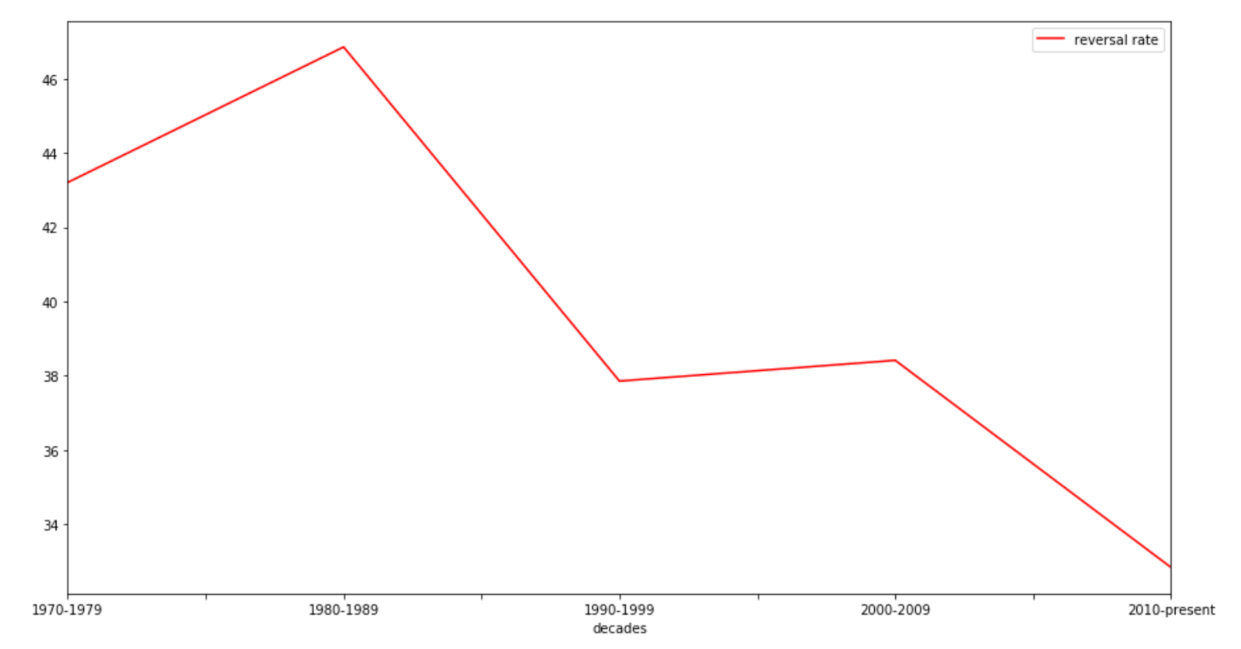
Data Analysis and Insights
Insight 2: Reversal Rate over past 5 decades
This decline in Reversal Rates indicate that we are gradually overcoming issues like variability and inconsistencies in the laws and the courts are now firm about the constitutional provisions and important legal issues to be considered while giving a judgement.

Slide 21
Thank You

